Slide 1
Introduction to Software Estimation
Lecturer: Ngo Huy Bien
Software Engineering Department
Faculty of Information Technology
VNUHCM - University of Science
Ho Chi Minh City, Vietnam
nhbien@fit.hcmus.edu.vn

Slide 2

Objectives
To communicate in software estimation field.
To estimate size and effort using counting, computing, and judging method.
To estimate size and effort using analogy method.
To estimate size and effort using structured expert judgment method.

Slide 3

Contents
Software Size Metrics.
Count, Compute, Judge.
Estimation by Analogy.
Structured Expert Judgment.

Slide 4

References
Steve McConnell (2006). Software Estimation: Demystifying the Black Art. Microsoft Press.
Jonathan Rasmusson (2010). The Agile Samurai: How Agile Masters Deliver Great Software. Pragmatic Bookshelf.

Slide 5

Problems
You have relatively good requirements (25 use cases or 80 user stories).
How long will it take to develop the system.
What is the cost?
How many people do you need to develop the system?
How much is your team’s productivity?

Slide 6
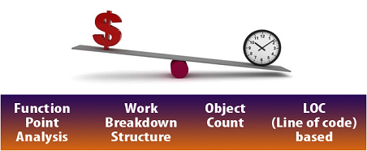
Software Estimation [1]
Software estimation is the act of predicting size, duration and cost of a project.
Who needs it?
Project Managers
Customers
Managers
Architects
Developers
Testers
Researchers

Slide 7

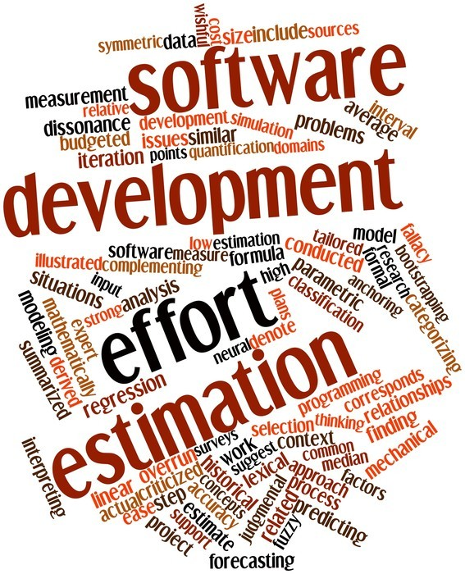

How Big is Your Software?
When will you complete your project if there is only you working on the project?
Effort = staff × time

Slide 8
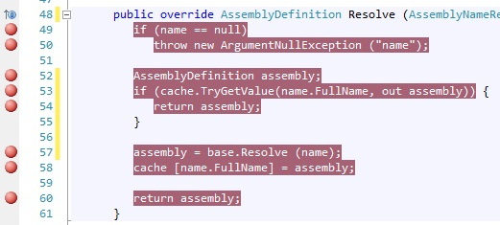
Source Lines of Code (SLOC)
Source lines of code — SLOC is a software metric used to measure the amount of code in a program.

Slide 9
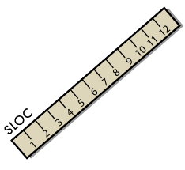
How many SLOC does your Project Have?
Well . . . it depends on how you count.
Physical SLOC
LOC (lines of code), SLOC (Source lines of code), logical SLOC — non-blank, non-comment, logical source lines. KLOC = 1000*LOC, KSLOC = 1000*SLOC
ELOC (Executable lines of code), DSI (Delivered source instructions) — SLOC but excludes data declarations, compiler declarations, and other lines that do not generate executable instructions.
ESLOC (Effective source lines of code) — SLOC that have been adjusted by the amount of rework required for portions of the system that were pre-existing at the start of the development.
Reused code
Language productivity factor

Slide 10

Pros & Cons of SLOC
Well understood, easy to count
Correlates well with functionality and effort
Other metrics can be derived from the SLOC metric: productivity (SLOC/(staff*month)) , quality (defects/SLOC) measurements
No SLOC exist at the onset of a project
At micro-level, SLOC can be misleading

Slide 11
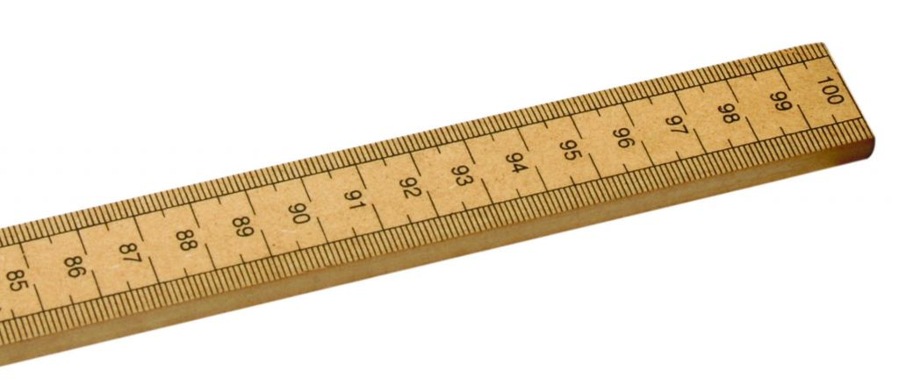
Other Metrics
Story point
Function points — FP is a software metric used to measure the delivered functionality in a program from user perspective.
Use case point, object point

Slide 12

Why Measure Software Size?
You cannot plan if you cannot measure, and if you fail to plan, you have planned to fail.
Request for proposals
Contract negotiations
Planning and scheduling
Monitoring and control
(productivity = size/time
quality = defects/size)

Slide 13

Estimate vs. Commitment
An estimate is a prediction of how long a project will take or how much it will cost.
A target is a statement of a desirable business objective.
These functions need to be completed by July 1 so that we'll be in compliance with government regulations.
A commitment is a promise to deliver defined functionality at a specific level of quality by a certain date.
Do not assume that the commitment has to be the same as the estimate.

Slide 14

Why Software Estimation?
It is to determine whether a project's targets are realistic enough to allow the project to be controlled to meet them.
It is used for making commitment.

Slide 15
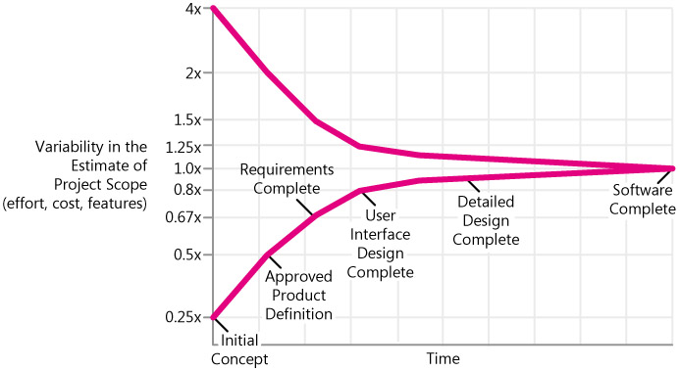

What If My Estimate is Not Correct
The Cone of Uncertainty
Can You Beat the Cone?

Slide 16
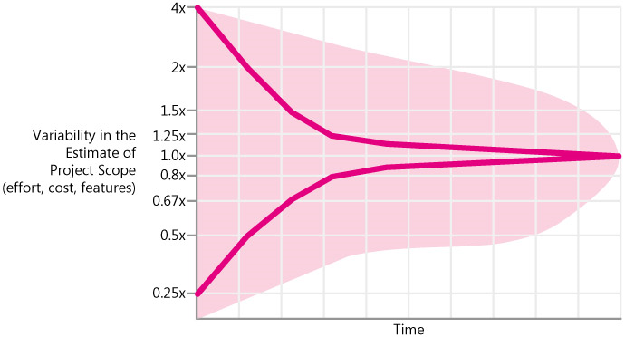
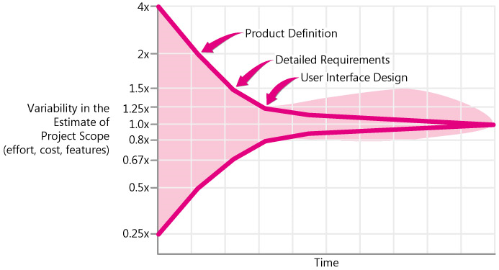
The Cone Doesn't Narrow Itself
If the project is not well controlled, or if the estimators aren't very skilled, estimates can fail to improve.
The Cone narrows only as you make decisions that eliminate variability.
Meaningful commitments are not possible in the early, wide part of the Cone.

Slide 17
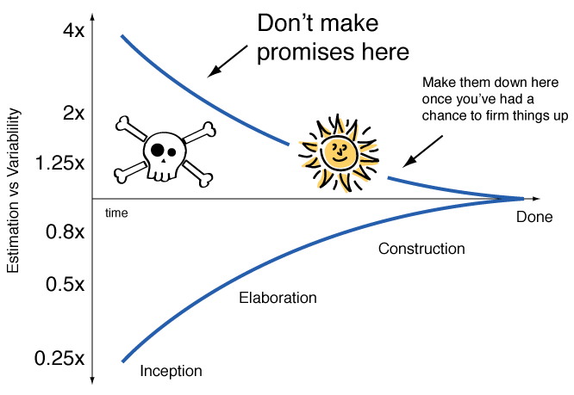
Again [2]

Slide 18
Iterative Development
You'll go through a miniature Cone on each iteration.
What you give up with approaches that leave requirements undefined until the beginning of each iteration is long-range predictability.
Your business might prioritize that flexibility highly, or it might prefer that your projects provide more predictability.
The alternative to total iteration is not no iteration. The alternatives are less iteration or different iteration.
Less iteration: Staged delivery.
Different iteration: Rational Unified Process.

Slide 19


Slide 20
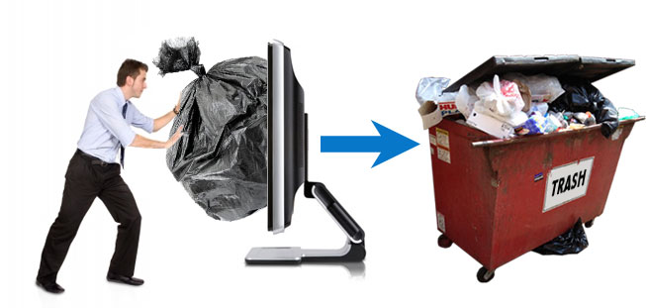
Inputs for Estimation
There is really no way we can expect the technique to compensate for our lack of definition or understanding of the software job to be done.
The inputs do not need to be detailed requirements.

Slide 22

Count, Compute, Judge [1]
How many students are there?
Count if at all possible.
Compute when you can't count.
Use judgment alone only as a last resort.

Slide 23

1. Decide What to Count
Find something to count that's available sooner.
Find something you can count with minimal effort.
Examples:
Marketing requirements
Features
Use cases
Stories
Web pages, dialog boxes
Reports
Database tables

Slide 24
2. Convert Counts to Estimates
If you collect historical data related to counts, you can convert the counts to something useful, such as estimated effort.
If you don't currently have historical data, begin collecting it as soon as possible.
Quantity to Count | Historical Data
Marketing requirements | Average effort hours per requirement for development
Features | Average effort hours per feature for development
Use cases | Average total effort hours per use case
Stories | Average total effort hours per story
Web pages | Average effort per Web page for user interface work

Slide 25

3. Use Judgment only as a Last Resort

Slide 26
Example (I)
Converting a .NET website (*.aspx, *.cs) to JEE
Counts:
Open powershell and execute below command
(gci -include *.aspx, *.skin, *.master, *.ascx -recurse | select-string .).Count
45 aspx files, 6996 lines of code
(gci -include *.cs, *.config -recurse | select-string .).Count
50 cs files, 12232 lines of code

Slide 27
Example (II)
Judgment:
45 aspx files, 6996 lines of code
20-day UI conversion
50 cs files, 12232 lines of code
30-day code conversion
JEE frameworks and tools investigation and review
10-day

Slide 28
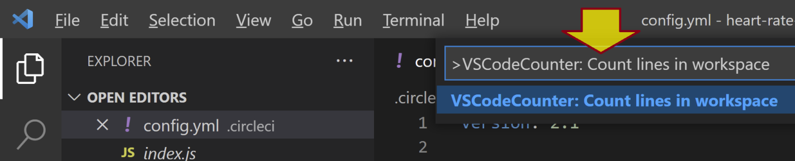
Tools (I)
VS Code Counter
https://marketplace.visualstudio.com/items?itemName=uctakeoff.vscode-counter
Get Lines of Code from GitHub
https://codetabs.com/count-loc/count-loc-online.html
Tokei
https://github.com/XAMPPRocky/tokei

Slide 29
Tools (II)
cloc
https://github.com/AlDanial/cloc

Slide 31

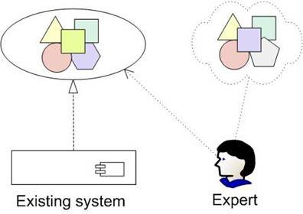
Estimation by Analogy

Slide 32
1. Get Detailed Size, Effort, and Cost Results for a Similar Previous Project
Old Project
Database | 5,000 lines of code (LOC) | 10 tables
User interface | 14,000 LOC | 14 Web pages
Graphs and reports | 9,000 LOC | 10 graphs + 8 reports
Foundation classes | 4,500 LOC | 15 classes
Business rules | 11,000 LOC | ???
TOTAL | 43,500 LOC

Slide 33
2. Compare the Size of the New Project to a Similar Past Project
Subsystem | Actual Size of Old Project | Estimated Size of New Project | Multiplication Factor
Database | 10 tables | 14 tables | 1.4
User interface | 14 Web pages | 19 Web pages | 1.4
Graphs and reports | 10 graphs + 8 reports | 14 graphs + 16 reports | 1.7
Foundation classes | 15 classes | 15 classes | 1.0
Business rules | ??? | ??? | 1.5

Slide 34
3. Build Up the Estimate for the New Project's Size as a Percentage of the Old Project's Size
Subsystem | Old Project | Multiplication Factor | New Project
Database | 5,000 | 1.4 | 7,000
User interface | 14,000 | 1.4 | 19,600
Graphs and reports | 9,000 | 1.7 | 15,300
Foundation classes | 4,500 | 1.0 | 4,500
Business rules | 11,000 | 1.5 | 16,500
TOTAL | 43,500 | - | 62,900

Slide 35
4. Create an Effort Estimate Based on the Size of the New Project Compared to the Previous Project
Term | Value
Size of New Project | 62,900 LOC
Size of Old Project | ÷ 43,500 LOC
Size ratio | = 1.45
Effort for Old Project | × 30 staff months
Estimated effort for New Project | = 44 staff months

Slide 36
5. Check for Consistent Assumptions Across the Old and the New Project
Unique properties
Technology
Team Members
Kinds Of Software

Slide 37
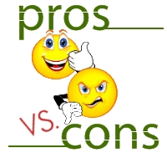
Pros & Cons of Analogy
Simple, accurate, cheap
Based on proven characteristics
Impossible if no comparable project has been tackled.
The need to determine the most important variables to be used for describing the solution.

Slide 39

Structured Expert Judgment
"intuitive expert judgment" tends to be inaccurate.
"structured expert judgment," can produce estimates that are about as accurate as model-based estimates.

Slide 40
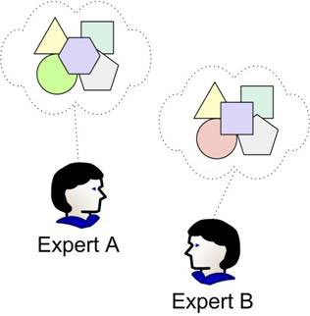
Who Creates the Estimates?
To create the task-level estimates, have the people who will actually do the work create the estimates.
Expert Estimator
Expert development, quality assurance, and documentation staff

Slide 41
Estimation by Decomposition
Feature | Estimated Staff Weeks to Complete
Feature 1 | 1.5
Feature 2 | 4
Feature 3 | 3
Feature 4 | 1
Feature 5 | 4
Feature 6 | 6
Feature 7 | 2
Feature 8 | 1
Feature 9 | 3
Feature 10 | 1.5
TOTAL | 27

Slide 42
Decomposition via an Activity-Based WBS
Category | Create/Do | Plan | Manage | Review | Rework | Report Defects
General management | • | • | • | •
Planning | • |  | • | • | •
Corporate activities (meetings, vacation, holidays, and so on) | •
Hardware setup/Software setup/Maintenance | • | • | • | • | • | •
Staff preparation | • | • | • | •
Technical Processes/Practices | • | • | • | • | • | •
Requirements work | • | • | • | • | • | •
Coordinate with other projects | • | • | • | •
Change management | • | • | • | • | • | •
User-interface prototyping | • | • | • | • | • | •
Architecture work | • | • | • | • | • | •
Detailed designing | • | • | • | • | • | •
Coding | • | • | • | • | • | •
Component acquisition | • | • | • | • | • | •
Automated build | • | • | • | • | • | •
Integration | • | • | • | • | • | •
Manual system tests | • | • | • | • | • | •
Automated system tests | • | • | • | • | • | •
Software release (interim, alpha, beta, and final releases) | • | • | • | • | • | •
Documents (user docs, technical docs) | • | • | • | • | • | •

Slide 43
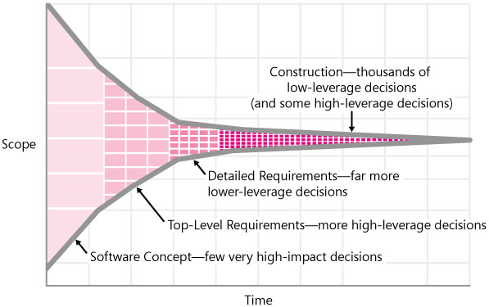
How Many Items?
Very early in a project, it can be a struggle to get enough detailed information to create a decomposed estimate.
Later in the project, you might have too much detail.
You need 5 to 10 individual items before you get much benefit from the Law of Large Numbers, but even 5 items are better than 1.

Slide 44
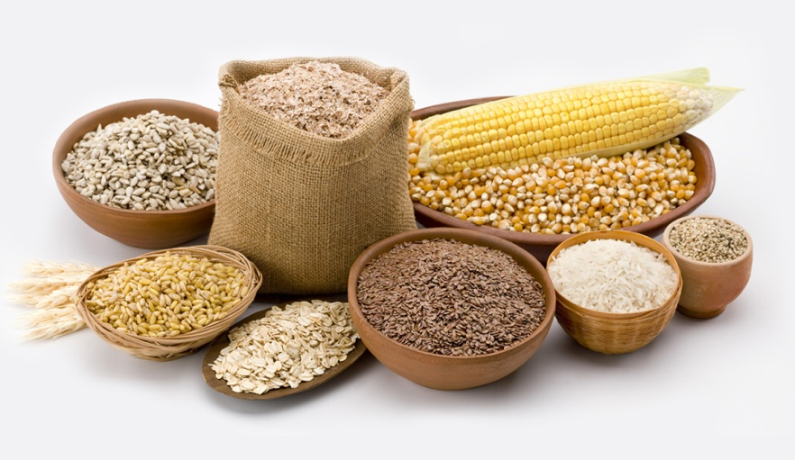
Task Granularity
One of the best ways to improve the accuracy of task-level estimates is to separate large tasks into smaller tasks.
When estimating at the task level, decompose estimates into tasks that will require no more than about 2 days of effort.
Ending up with estimates that are at the 1/4 day, 1/2 day, or full day of granularity is appropriate.

Slide 45
Why Does It Works? – The Law of Large Numbers
Feature | Estimated Staff Weeks to Complete | Actual Effort | Raw Error | Magnitude of Relative Error
Feature 1 | 1.5 | 3.0 | -1.5 | 50%
Feature 2 | 4.5 | 2.5 | 2.0 | 80%
Feature 3 | 3 | 1.5 | 1.5 | 100%
Feature 4 | 1 | 2.5 | -1.5 | 60%
Feature 5 | 4 | 4.5 | -0.5 | 11%
Feature 6 | 6 | 4.5 | 1.5 | 33%
Feature 7 | 2 | 3.0 | -1.0 | 33%
Feature 8 | 1 | 1.5 | -0.5 | 33%
Feature 9 | 3 | 2.5 | 0.5 | 20%
Feature 10 | 1.5 | 3.5 | -2.0 | 57%
TOTAL | 27 | 29 | -2 | -
Average | - | - | -7% | 46%

Slide 46
The Issue of Best Case Estimates
Feature | Estimated Staff Weeks to Complete | Actual Effort
Feature 1 | 1.6 | 3.0
Feature 2 | 1.8 | 2.5
Feature 3 | 2.0 | 1.5
Feature 4 | 0.8 | 2.5
Feature 5 | 3.8 | 4.5
Feature 6 | 3.8 | 4.5
Feature 7 | 2.2 | 3.0
Feature 8 | 0.8 | 1.5
Feature 9 | 1.6 | 2.5
Feature 10 | 1.6 | 3.5
TOTAL | 20.0 | 29.0
The root cause is a combination of the "90% confident" problem.
When developers are asked to provide single-point estimates, they often unconsciously present Best Case estimates.
P(F1 completed on time)
= 0.25 (not bad)
P (All completed on time) = P(F1)*P(F2)*P(F3)*…*P(F10) = 0.000095% (extremely small)
Solution: ?

Slide 47
Solution: Use of Ranges
Feature | Estimated Days to Complete
 | Best Case | Worst Case
Feature 1 | 1.25 | 2.0
Feature 2 | 1.5 | 2.5
Feature 3 | 2.0 | 3.0
Feature 4 | 0.75 | 2.0
Feature 5 | 0.5 | 1.25
Feature 6 | 0.25 | 0.5
Feature 7 | 1.5 | 2.5
Feature 8 | 1.0 | 1.5
Feature 9 | 0.5 | 1.0
Feature 10 | 1.25 | 2.0
TOTAL | 10.5 | 18.25
Should we use the mathematical midpoint?

Slide 48
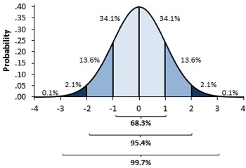
Formulas
In many cases, the Worst Case is much worse than what's called the Expected Case.
Taking the midpoints of the ranges could result in an unnecessarily high estimate.
You can estimate the Most Likely Case using expert judgment.
You then calculate the Expected Case using this formula (Program Evaluation and Review Technique (PERT)):
Expected Case = (Optimistic + (4 X Most Likely) + Pessimistic)/6

Slide 49
Example
Feature | Estimated Days to Complete
 | Best Case (25% Likely) | Most Likely Case | Worst Case (75% Likely) | Expected Case (50% Likely)
Feature 1 | 1.25 | 1.5 | 2.0 | 1.54
Feature 2 | 1.5 | 1.75 | 2.5 | 1.83
Feature 3 | 2.0 | 2.25 | 3.0 | 2.33
Feature 4 | 0.75 | 1 | 2.0 | 1.13
Feature 5 | 0.5 | 0.75 | 1.25 | 0.79
Feature 6 | 0.25 | 0.5 | 0.5 | 0.46
Feature 7 | 1.5 | 2 | 2.5 | 2.00
Feature 8 | 1.0 | 1.25 | 1.5 | 1.25
Feature 9 | 0.5 | 0.75 | 1.0 | 0.75
Feature 10 | 1.25 | 1.5 | 2.0 | 1.54
TOTAL | 10.5 | 13.25 | 18.25 | 13.62

Slide 50
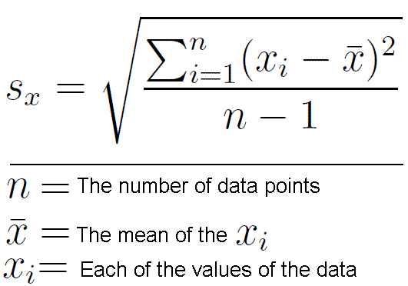
Percentage Confident
Percentage Confident | Calculation
2% | Expected case - (2 x StandardDeviation)
10% | Expected case - (1.28 x StandardDeviation)
16% | Expected case - (1 x StandardDeviation)
20% | Expected case - (0.84 x StandardDeviation)
25% | Expected case - (0.67 x StandardDeviation)
30% | Expected case - (0.52 x StandardDeviation)
40% | Expected case - (0.25 x StandardDeviation)
50% | Expected case
60% | Expected case + (0.25 x StandardDeviation)
70% | Expected case + (0.52 x StandardDeviation)
75% | Expected case + (0.67 x StandardDeviation)
80% | Expected case + (0.84 x StandardDeviation)
84% | Expected case + (1 x StandardDeviation)
90% | Expected case + (1.28 x StandardDeviation)
98% | Expected case + (2 x StandardDeviation)

Slide 51

Checklist for Individual Estimates
Is what's being estimated clearly defined?
Does the estimate include all the kinds of work needed to complete the task?
Does the estimate include all the functionality areas needed to complete the task?
Is the estimate broken down into enough detail to expose hidden work?
Did you look at documented facts (written notes) from past work rather than estimating purely from memory?
Is the estimate approved by the person who will actually do the work?

Slide 52
Compare Estimates to Actuals
Keep a list of your estimates, and fill in your actual results when you complete them.
Then compute the Magnitude of Relative Error (MRE) of your estimates.
When you compare your actual performance to your estimates, you should try to understand what went right, what went wrong, what you overlooked, and how to avoid making those mistakes in the future.
 | Estimated Days to Complete
Feature | Best Case | Worst Case | Expected Case | Actual Outcome | MRE | In Range from Best Case to Worst Case?
Feature 1 | 1.25 | 2 | 1.54 | 2 | 23% | Yes
Feature 2 | 1.5 | 2.5 | 1.83 | 2.5 | 27% | Yes
Feature 3 | 2 | 3 | 2.33 | 1.25 | 87% | No

Slide 53

Pros & Cons of Expert Opinion
Can be used in
a new business area,
new technology, or
a brand-new kind of software
Cannot be quantified
Requires experts

Slide 55
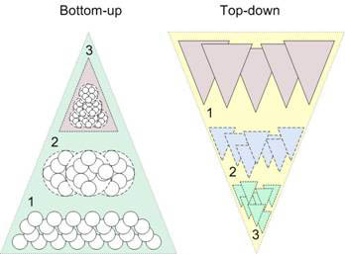
Top-Down and Bottom-Up [1]
Any of these approaches may be used top-down or bottom-up.
Start at the component level and estimate the effort required for each component. Add these efforts to reach a final estimate.
Start at the system level and assess the overall system functionality and how this is delivered through sub-systems.
Usable when the architecture of the system is known and components identified.
It may underestimate the costs of system level activities such as integration and documentation.
Usable without knowledge of the system architecture and the components that might be part of the system.
Can underestimate the cost of solving difficult low-level technical problems.

Slide 56
Question 1
Is it better to overestimate or underestimate?

Slide 57
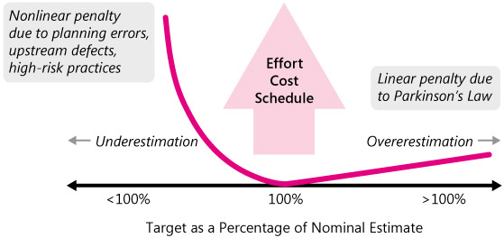
Answer 1

Slide 58
Question 2
In most of the companies, presales and marketing gurus will set the figures and the due date even before you start communicating with your client as proceed to the analysis phase.
My question is when you can do the estimation.

Slide 59
Answer 2
In that case you can use “Price to Win” technique.
The estimated effort depends upon the customer's budget and not on the software functionality.
The estimate is made as low as necessary to win the job.
When you're asked to provide an estimate, determine whether you're supposed to be estimating or figuring out how to hit a target.
"The price-to-win technique has won a large number of software contracts for a large number of software companies. Almost all of them are out of business today."[Boehm 81], p337.

Slide 60
Question3
EXECUTIVE: How long do you think this project will take? We need to have this software ready in 3 months for a trade show. I can't give you any more team members, so you'll have to do the work with your current staff. Here's a list of the features we'll need.
PROJECT LEAD: OK, let me crunch some numbers, and get back to you.
Later…
PROJECT LEAD: We've estimated the project will take 5 months.
EXECUTIVE: Five months!? Didn't you hear me? I said we needed to have this software ready in 3 months for a trade show!
PROJECT LEAD: ???

Slide 61
Answer 3
Software may be priced (estimated) to gain a contract and the functionality adjusted to the price.

Slide 62
Best Practices
Using more than one estimation technique.
Including risk impact.

Slide 63

Thank You & See You Again

